Slide 1
Lyons' Memorial Site

Slide 2
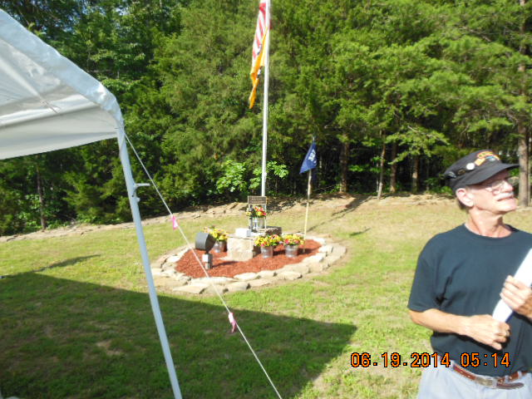
The Lyons' Memorial Site for Airborne Brothers

Slide 3
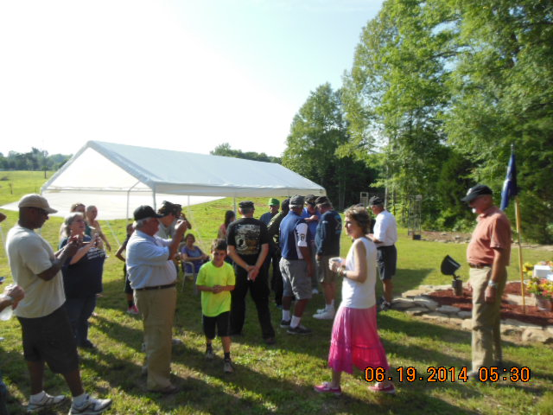
Start of memorial for fallen brothers

Slide 4
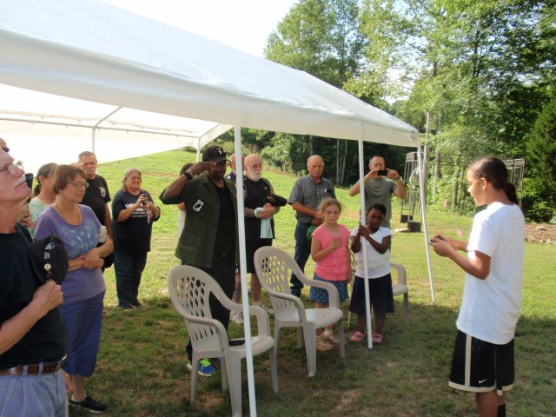
National anthem sung by young girl with a voice like an angel.

Slide 5
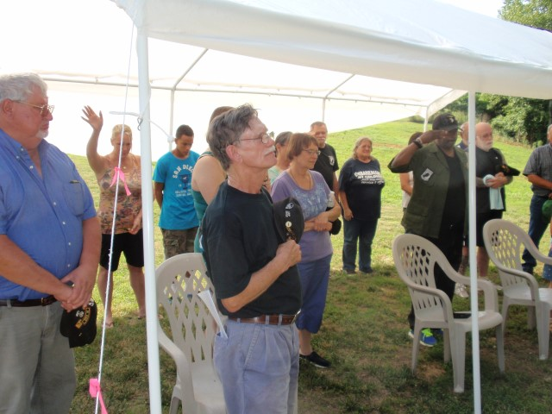
In remembrance

Slide 6
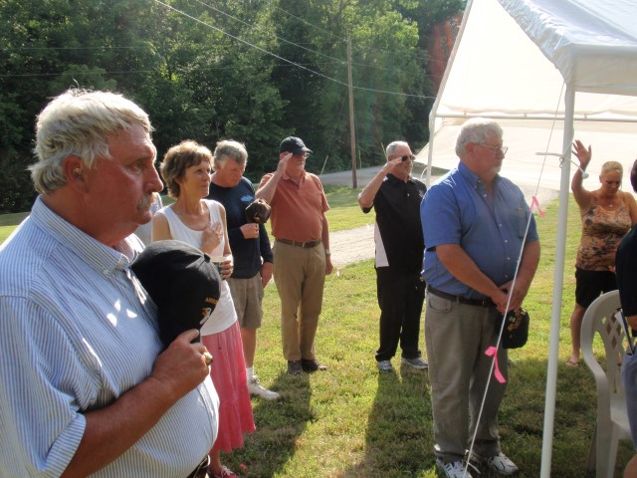

Slide 7
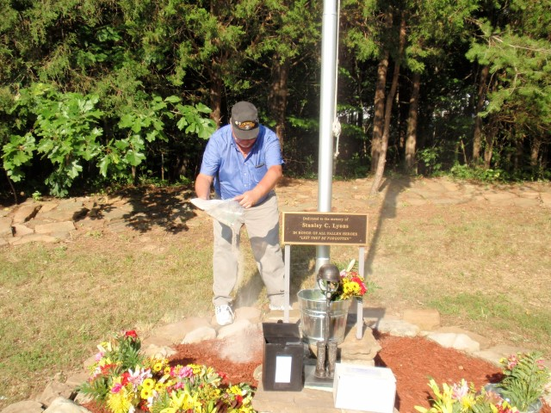
Spreading our Brother Ron’s ashes

Slide 8
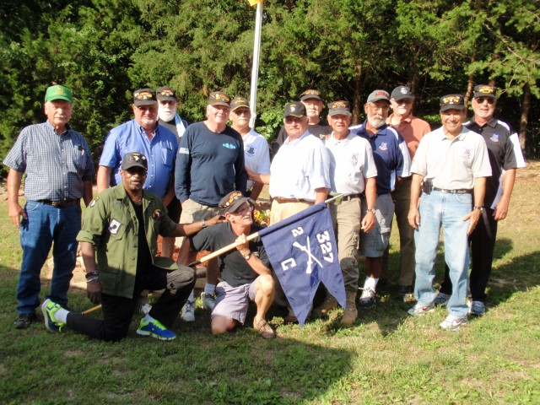
“C” Company Troopers
Ft from rt: Danny “Duck” Pitman, Frank “Bulldog” Drummond 2nd row: Steve “Doc” Vargo, Jim “Doc” Webb, Rich Walsh, Barry McCleary, Richard “Pointman” Bathurst, Larry Cota, Sal “Doc” Melendez, rear row: Joe Bernstein, John Davis, Ted Penton, Mike McDermitt, Ken Kesinger

Slide 9
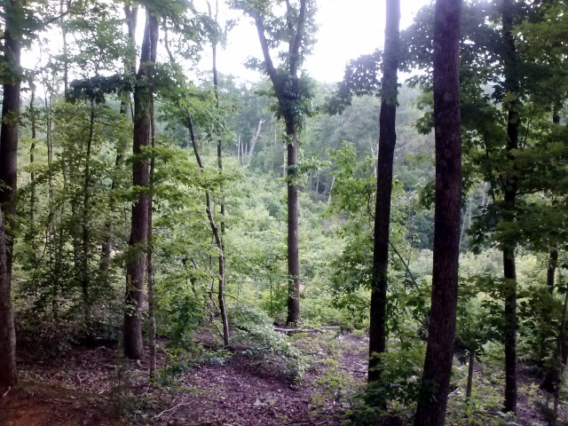
View of one of Ron’s hiking sites

Slide 10
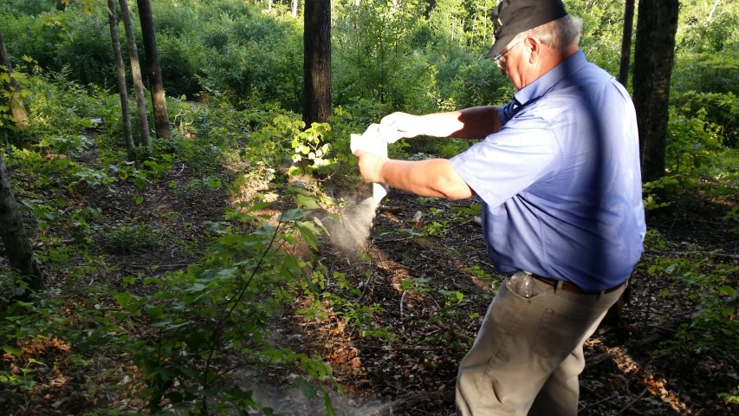
Ron returning to hiking site

Slide 11
Cobra Memorial Site

Slide 12
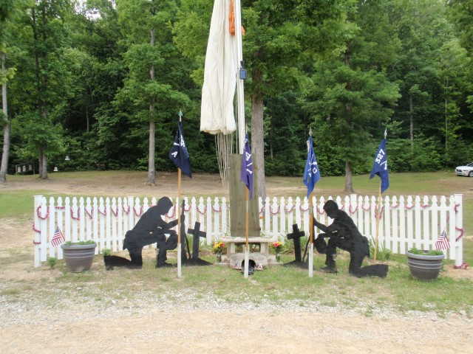
Cobra Lake Memorial Site

Slide 13
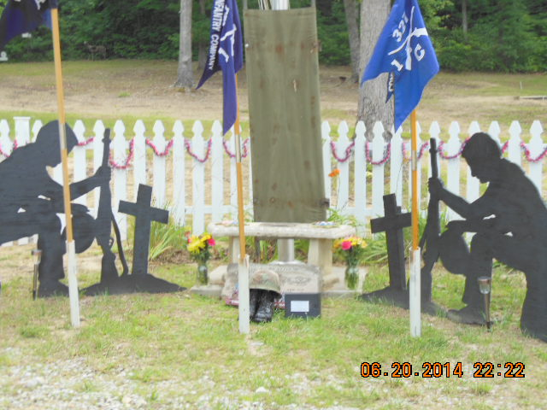

Slide 14
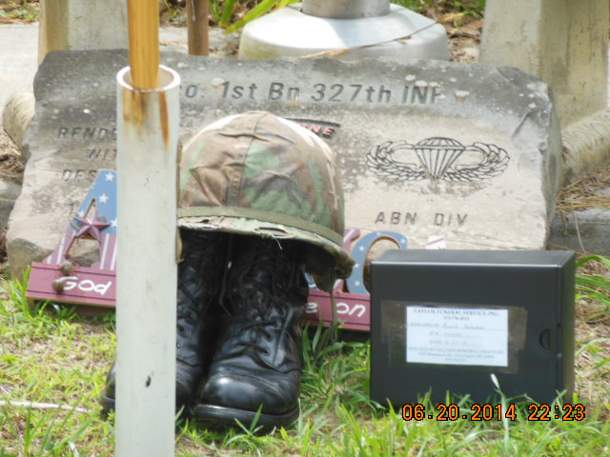
Ron’s ashes

Slide 15
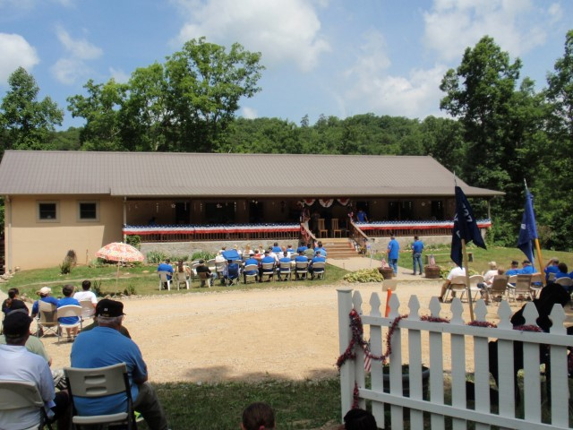
The home of our host and hostess

Slide 16
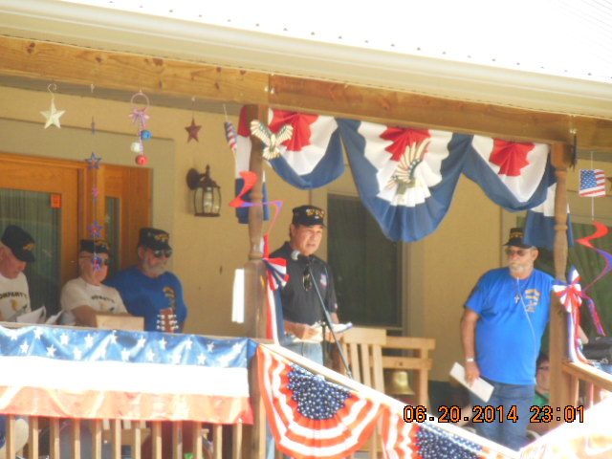
Sal reading memorial to Brother Ron

Slide 17
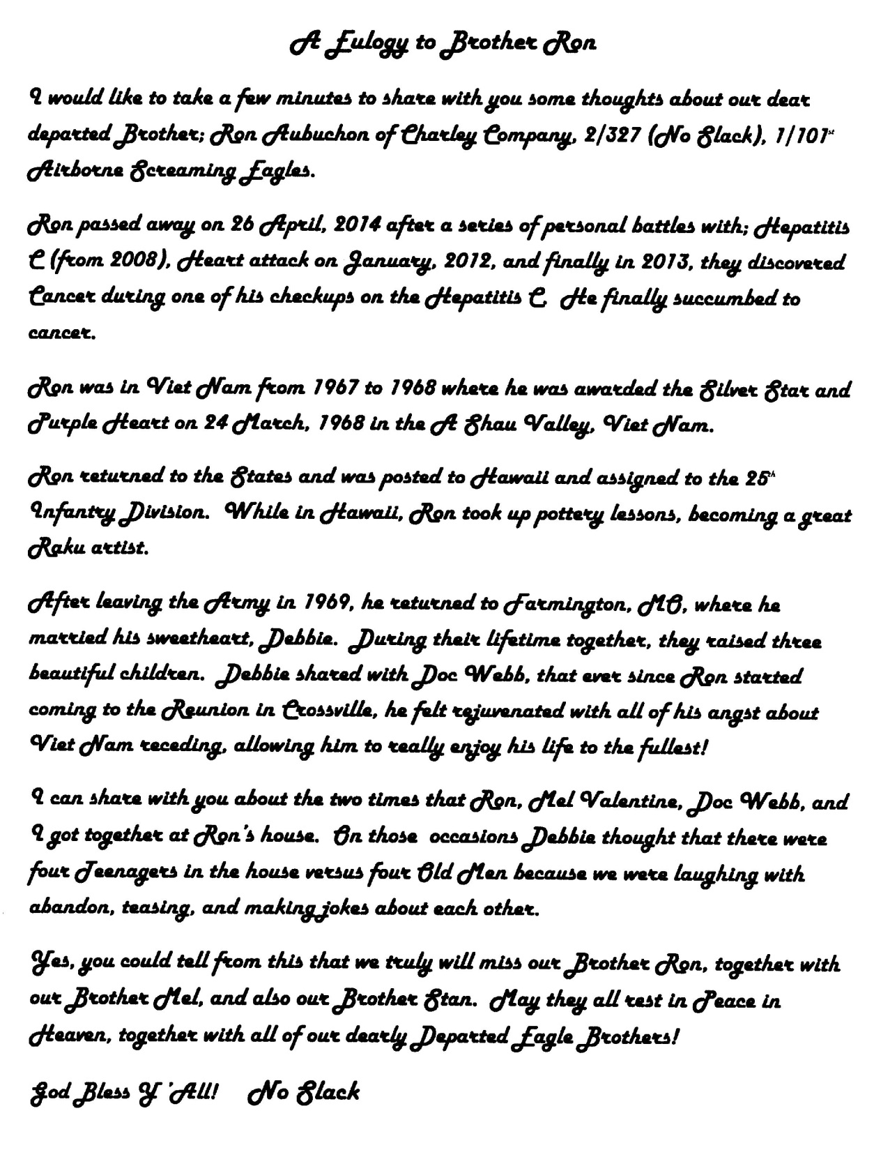

Slide 18
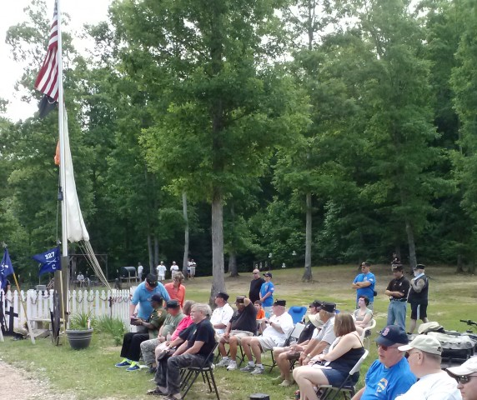
Preparing to spread ashes

Slide 19
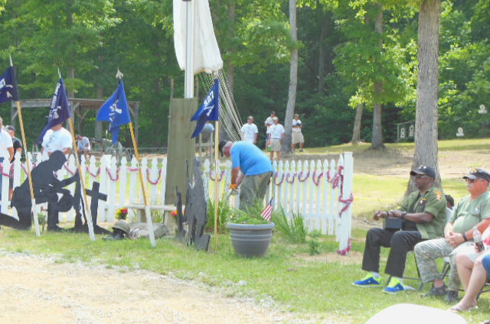
Laying Ron to rest at Cobra Lake

Slide 20
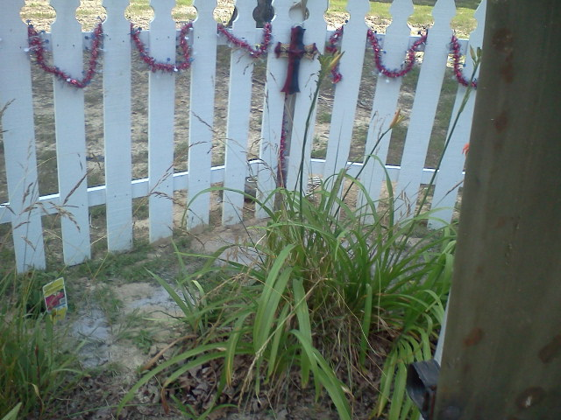
Ron’s wish fulfilled

Slide 21
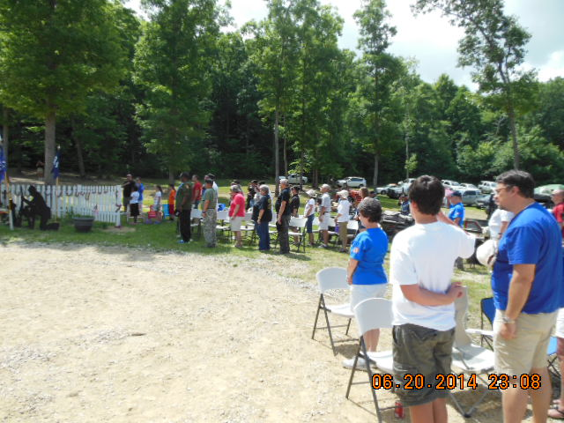
Honoring those gone

Slide 22
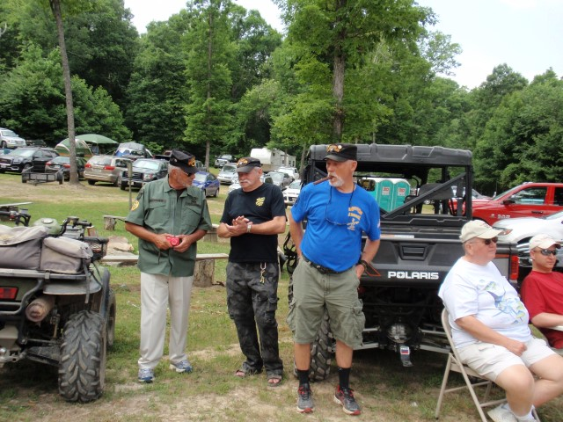
Ron’s brothers Ken Kesinger and Ted Penton (left)

Slide 23
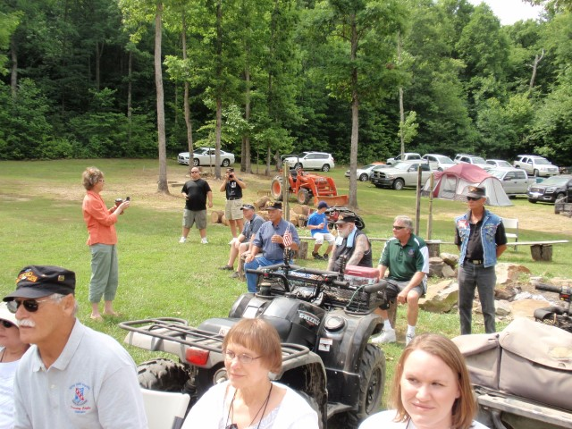
Ft: Vera and John Davis, Linda and MindyValentine
lady in orange is Linda Lyons

Slide 24
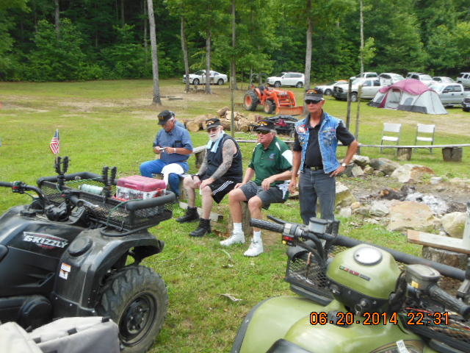
“C” Company Brothers

Slide 25
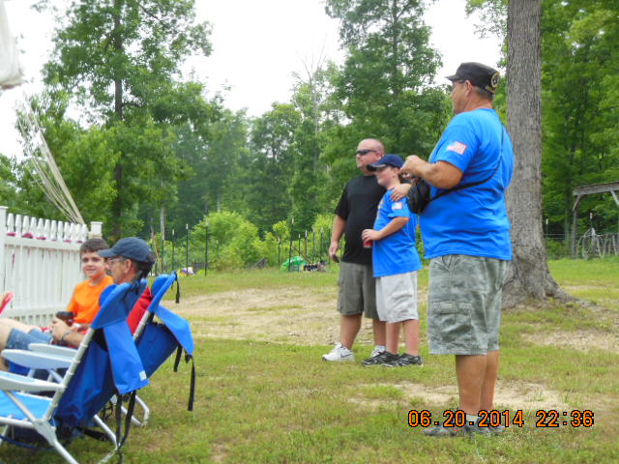
More than one generation at memorial.

